Slide 1
Repository name: grade-calculator
Description: Student Grade Calculator Python Project

Slide 2
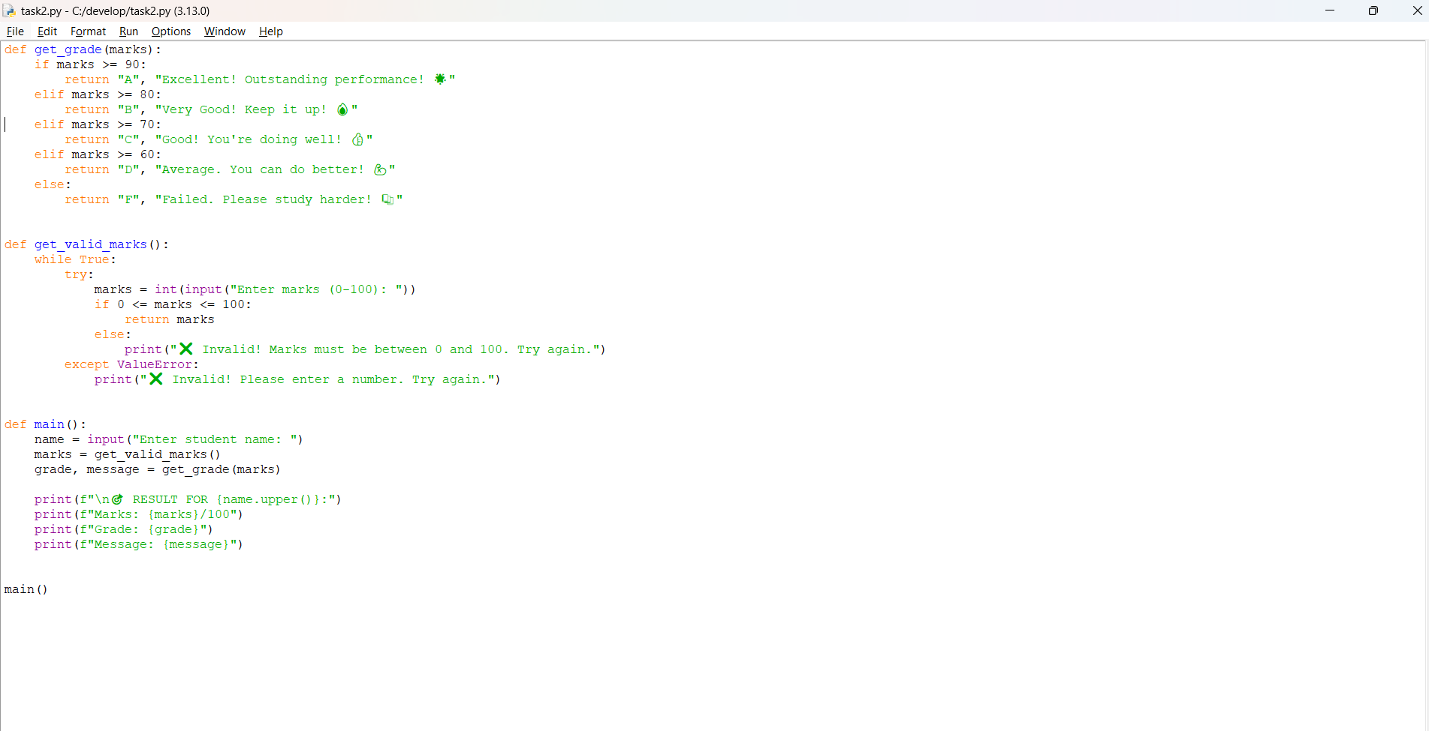

Slide 3
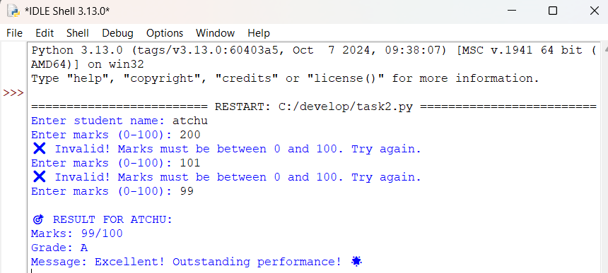

Slide 4
